Slide 1
Microsoft Dynamics AX 2012 Administration Workshop Chapter 10: Reporting
Presenter Name
Presenter Title
Presenter Company

Slide 2
Conditions and Terms of Use
Microsoft Confidential
This training package is proprietary and confidential, and is intended only for uses described in the training materials. Content and software is provided to you under a Non-Disclosure Agreement and cannot be distributed. Copying or disclosing all or any portion of the content and/or software included in such packages is strictly prohibited.
The contents of this package are for informational and training purposes only and are provided "as is" without warranty of any kind, whether express or implied, including but not limited to the implied warranties of merchantability, fitness for a particular purpose, and non-infringement.
Training package content, including URLs and other Internet Web site references, is subject to change without notice. Because Microsoft must respond to changing market conditions, the content should not be interpreted to be a commitment on the part of Microsoft, and Microsoft cannot guarantee the accuracy of any information presented after the date of publication. Unless otherwise noted, the companies, organizations, products, domain names, e-mail addresses, logos, people, places, and events depicted herein are fictitious, and no association with any real company, organization, product, domain name, e-mail address, logo, person, place, or event is intended or should be inferred.
Copyright and Trademarks
© 2013 Microsoft Corporation. All rights reserved.
Microsoft may have patents, patent applications, trademarks, copyrights, or other intellectual property rights covering subject matter in this document. Except as expressly provided in written license agreement from Microsoft, the furnishing of this document does not give you any license to these patents, trademarks, copyrights, or other intellectual property.
Complying with all applicable copyright laws is the responsibility of the user. Without limiting the rights under copyright, no part of this document may be reproduced, stored in or introduced into a retrieval system, or transmitted in any form or by any means (electronic, mechanical, photocopying, recording, or otherwise), or for any purpose, without the express written permission of Microsoft Corporation.
For more information, see Use of Microsoft Copyrighted Content at http://www.microsoft.com/about/legal/permissions/
Microsoft®, Microsoft Dynamics®, SharePoint®, SQL Server®, Visual Studio®, Windows®, and Windows PowerShell® are either registered trademarks or trademarks of Microsoft Corporation in the United States and/or other countries. Other Microsoft products mentioned herein may be either registered trademarks or trademarks of Microsoft Corporation in the United States and/or other countries. All other trademarks are property of their respective owners.

Slide 3
Students: How to View this Presentation
Switch to Notes Page view
Click View on the ribbon and select Notes Page
Use page up or page down to navigate
Zoom in or out as needed
Most slides will have supporting text that you can view now or after the delivery
Add notes to your copy of the presentation if you want to
You take the presentation files home with you.
Notes:
If this presentation is intended for a Workshop, this slide and the subsequent slide will need to remain in the PPT

Slide 4
Objective
Review the reporting architecture
Review planning considerations
Discuss how to run a report in batch
Install and deploy SSRS reports
Configure a report server
Security considerations

Slide 5
Introduction
All reports are created in SQL Server Reporting Services. MorphX reports are deprecated.
Reporting Services enables users to create and publish traditional, paper-based reports, as well as interactive web-based reports.
Before you integrate Microsoft Dynamics AX and Reporting Services, it is important that you have a basic understanding of Reporting Services concepts.
Notes:
In Microsoft Dynamics AX 2012, all reports are created in SQL Server Reporting Services (SSRS). The move to SSRS puts Microsoft Dynamics AX reports on Microsoft's preferred reporting platform. This transition helps improve end-user productivity through rich, graphical, and interactive reports while more easily and automatically integrating Microsoft Dynamics AX concepts and metadata into Reporting Services with less code and less effort. The goals for this transition include the following:
Improved integration with the Microsoft Business Intelligence stack
Writing reports that make use of Microsoft Dynamics AX business logic
Performance as good as, or better than, X++ reports
Simplify the transition for X++ and C# developers to the new reporting architecture
Reporting Services is a server-based solution that enables users to create and publish traditional, paper-based reports, as well as interactive web-based reports.
Before you integrate Microsoft Dynamics AX and Reporting Services, it is important that you have a basic understanding of Reporting Services concepts.

Slide 6
Introduction (continued)
The new SSRS Reporting framework has three key improvements:
Reports automatically react to Microsoft Dynamics AX 2012 metadata.
It is easier to use Microsoft Dynamics AX Business logic in X++.
Deeper integration into the Microsoft Dynamics AX client experience and batch framework.
The following reporting features have been added in Microsoft Dynamics AX 2012 R2:
Support for data partitions - A Microsoft Dynamics AX 2012 R2 installation may consist of multiple data partitions.
Support for report servers that run in SharePoint integrated mode - Reporting Services can be installed in native mode or SharePoint integrated mode.
Notes:
The new SSRS Reporting framework has three key improvements:
Reports automatically react to Microsoft Dynamics AX 2012 metadata
It is easier to use Microsoft Dynamics AX Business logic in X++
Deeper integration into the Microsoft Dynamics AX client experience and batch framework
The SQL Server Reporting Services (SSRS) reporting architecture in Microsoft Dynamics AX 2012 is modified to follow a Model-View-Controller (MVC) design pattern variation.
This architecture means many different client types can call Microsoft Dynamics AX 2012 SSRS reports including: Microsoft Dynamics AX clients, Enterprise Portal, and Batch Job. This also means that SSRS could be replaced by a different application for rendering reports.
Build rich and interactive reports - improved end-user productivity through rich, graphical and interactive reports. You can easily and automatically integrate Microsoft Dynamics AX concepts and metadata into Reporting Services with less code and less effort.
Reports now use services instead of the .NET Business Connector to retrieve Microsoft Dynamics AX online transaction processing (OLTP) data.

Slide 7
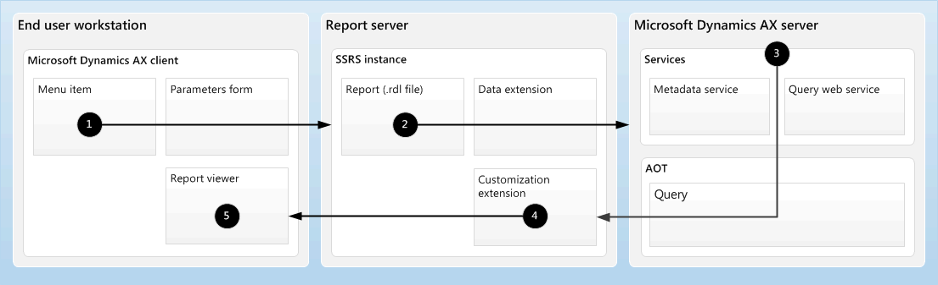
Reporting Architecture – Native Mode SSRS
Notes:
1. A user requests a report.
A menu item in the Microsoft Dynamics AX client may be bound to a report for Reporting Services. After a user clicks the menu item, a parameters form is displayed to the user. The user enters parameters to filter the data that is displayed on the report.
The Microsoft Dynamics AX client then requests the report from an instance of Reporting Services. The request includes the parameters that the user entered.
2. Reporting Services receives the request and requests the report data from the Microsoft Dynamics AX server.
Reporting Services receives the request and examines the report. The report is stored as an .rdl file. The .rdl file indicates the report’s data source. The data source may be a Microsoft Dynamics AX query, a report data provider class, or an external data source that is accessed through report data methods.
If a Microsoft Dynamics AX data source is used for the report, Reporting Services uses the Microsoft Dynamics AX data extension to retrieve the data.
Reporting Services then requests metadata about the data source from Microsoft Dynamics AX. Then Reporting Services requests the data for the report.
3. The Microsoft Dynamics AX server receives the request and sends the report data back to Reporting Services.
The Microsoft Dynamics AX services examine the query in the Application Object Tree (AOT) to return the requested metadata. The services also run the query to generate the data for the report.
Microsoft Dynamics AX then returns the metadata and data to Reporting Services.
Note Microsoft Dynamics AX enforces security on all data that it returns. If the user who is running the report is not allowed to see a specific field, the data for that field is not returned.

Slide 8
Notes Continued
Notes:
4. Reporting Services renders the report and sends it to the Microsoft Dynamics AX client.
The Microsoft Dynamics AX customization extension formats the report. The customization extension uses metadata to provide automatic formatting of data and can affect the positioning and layout of elements on the report.
Reporting Services then renders the report into a visual representation and sends that representation to the Microsoft Dynamics AX client.
5. The report is displayed to the user.
The Microsoft Dynamics AX client displays the report to the user in the report viewer control.

Slide 9
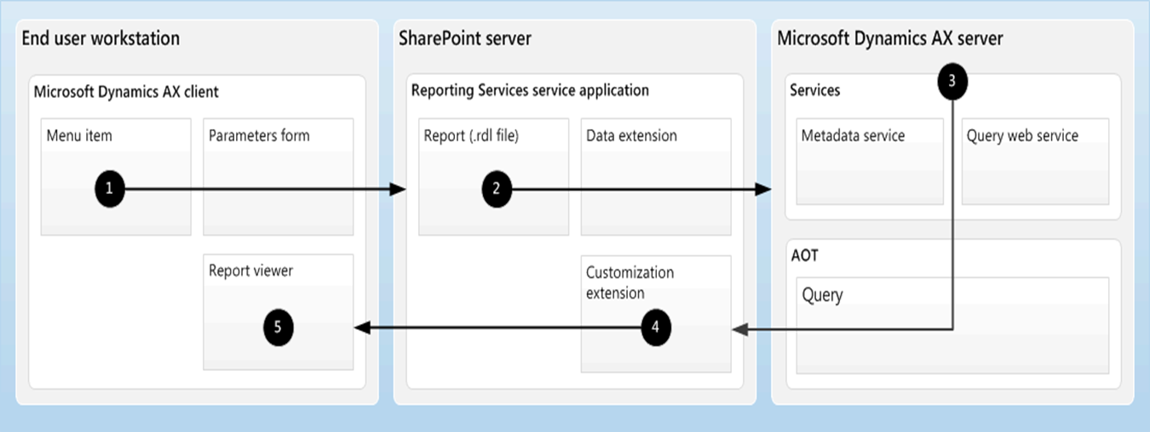
Reporting Architecture –SSRS SharePoint Integrated Mode
Notes:
1. A user requests a report.
A menu item in the Microsoft Dynamics AX client may be bound to a report for Reporting Services. After a user clicks the menu item, a parameters form is displayed to the user. The user enters parameters to filter the data that is displayed on the report.
The Microsoft Dynamics AX client then requests the report from the Reporting Services service application in SharePoint. The request includes the parameters that the user entered.
2. The Reporting Services service application receives the request and requests the report data from the Microsoft Dynamics AX server.
The Reporting Services service application receives the request and examines the report. The report is stored as an .rdl file. The .rdl file indicates the report’s data source. The data source may be a Microsoft Dynamics AX query, a report data provider class, or an external data source that is accessed through report data methods.
If a Microsoft Dynamics AX data source is used for the report, the Reporting Services service application uses the Microsoft Dynamics AX data extension to retrieve the data.
The Reporting Services service application then requests metadata about the data source from Microsoft Dynamics AX. Then the Reporting Services service application requests the data for the report.
3. The Microsoft Dynamics AX server receives the request and sends the report data back to the Reporting Services service application.
The Microsoft Dynamics AX services examine the query in the Application Object Tree (AOT) to return the requested metadata. The services also run the query to generate the data for the report.
Microsoft Dynamics AX then returns the metadata and data to the Reporting Services service application.
Note Microsoft Dynamics AX enforces security on all data that it returns. If the user who is running the report is not allowed to see a specific field, the data for that field is not returned.

Slide 10
Notes Continued
Notes:
4. The Reporting Services service application renders the report and sends it to the Microsoft Dynamics AX client.
The Microsoft Dynamics AX customization extension formats the report. The customization extension uses metadata to provide automatic formatting of data and can affect the positioning and layout of elements on the report.
The Reporting Services service application then renders the report into a visual representation and sends that representation to the Microsoft Dynamics AX client.
5. The report is displayed to the user.
The Microsoft Dynamics AX client displays the report to the user in the report viewer control.

Slide 11
Planning Considerations for Reporting
Topology
Customizations
Architectural considerations for reporting
Notes:
It is recommended that you consider the following information before implementing the reporting features of Microsoft Dynamics AX.
Topology
Before selecting a topology, consider the following question:
Will you implement Reporting Services in a scale-out deployment or failover cluster?
Reporting Services offers several approaches for deploying server components:
Scale-out deployment: A report server scale-out deployment is two or more report server instances that share a single report server database. A scale-out deployment enables you to increase the number of users who concurrently access reports and improve the availability of the report server. For more information, refer to the SQL Server documentation on TechNet.
Failover cluster: SQL Server provides failover clustering support so that you can use multiple disks for one or more SQL Server instances. Failover clustering is supported only for the report server database; you cannot run the Reporting Services Windows service as part of a failover cluster. For more information, refer to the SQL Server documentation on TechNet.

Slide 12
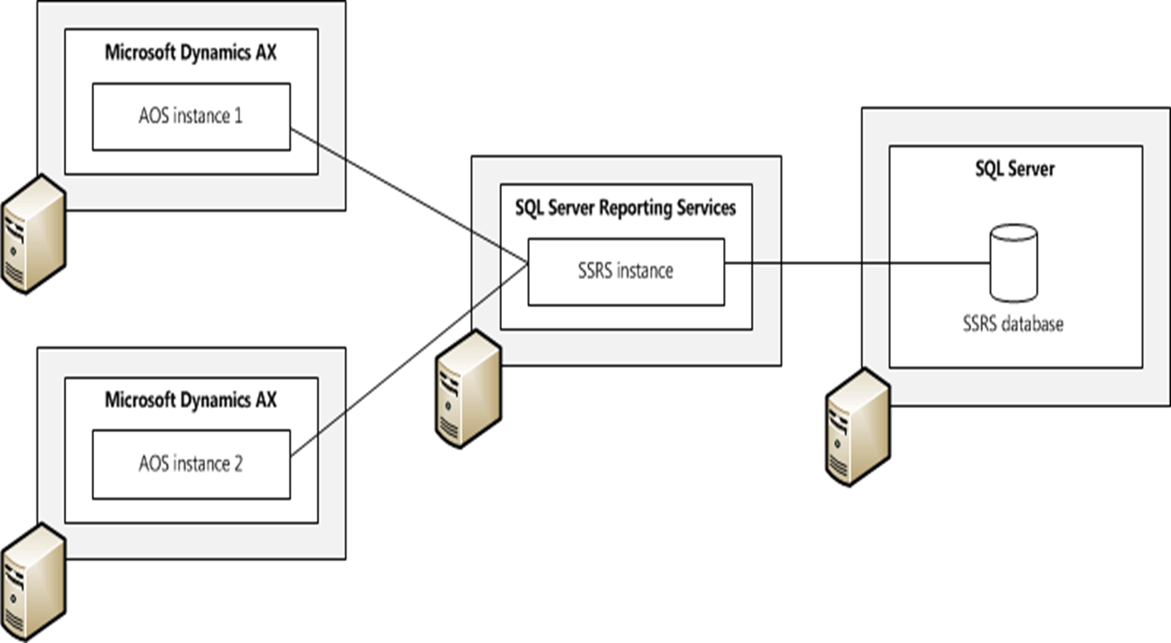
AOS scale-out deployment with Reporting Services

Slide 13
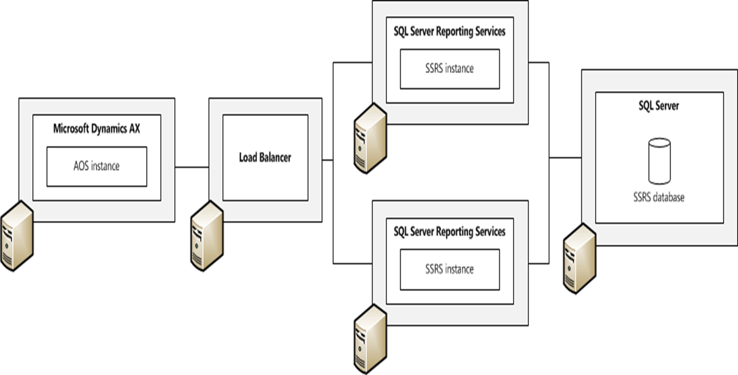
Reporting Services scale-out deployment
Notes:
Scale-out deployment: A report server scale-out deployment is two or more report server instances that share a single report server database. A scale-out deployment enables you to increase the number of users who concurrently access reports and improve the availability of the report server. For more information, refer to the SQL Server documentation on TechNet.

Slide 14
Batch Support for Reports
SSRS reports in Microsoft Dynamics AX 2012 can be integrated with the Microsoft Dynamics AX batch framework. This enables you to:
Schedule a long-running report to be printed during off-peak hours.
Schedule a report to be printed on a recurring basis.
All print destinations except print on-screen can be set for printing reports in batch. Print destinations are Print Archive, Printer, File and Email.
Notes:
SSRS reports in Microsoft Dynamics AX 2012 can now be integrated with the Microsoft Dynamics AX batch framework. This enables you to:
Schedule a long-running report to be printed during off-peak hours
Schedule a report to be printed on a recurring-basis
Many tasks in Microsoft Dynamics AX can be run as part of batch jobs. For example, batch jobs can include tasks for printing reports, performing maintenance, or sending electronic documents. By using batch jobs, you can avoid slowing down your computer or the server during typical working hours.
Most batch tasks can be run on a batch server, but some must be run on the client. Tasks that run on the server can run automatically as part of batch jobs, regardless of whether a client is open. However, tasks that run on the client must be run manually by using the Set up batch processing form. If a client task is marked Private, only the user who created that task can run it.
The tasks in a batch job can run sequentially or at the same time. In addition, you can create dependencies between tasks. This means that you can set up a different sequence of tasks depending on whether an earlier task succeeds or fails.
You can set up recurrence patterns for batch jobs. For example, you can set up a job to process invoices automatically at the end of every month.

Slide 15
Set up a Report as a Batch
Scenario
You would like Microsoft Dynamics AX 2012 to send a weekly email that includes a report that lists the order lines not invoiced
Procedure
Accounts receivable > Reports > Transactions > Sales order > Order lines not invoiced
Notes:
Open Accounts receivable > Reports > Transactions > Sales order > Order lines not invoiced.
Click Destinations.
In the left pane, select E-mail.
In To, select Kevin@contoso.com. (mailto:Kevin@contoso.com.)
In Subject, type Order lines not invoiced report, and then click OK.
Select the Batch tab.
Select Batch Processing.
Set the Batch group to the desired batch group.
Click Recurrence.
In Range of recurrence, select No end date.
In Recurring pattern, select Weeks.
In Fixed weekly interval, type 1.
Select Friday, and then click OK.
Click OK.

Slide 16
Lab 1: Create an SSRS Auto-Report
Lab Scenario
You would like to print a report that has all Item charge groups, but you do not see a predefined report for Item charge groups.
Accounts receivable > Setup > Charges > Item charges groups.
Notes:
To set up the sales order invoice job to run every four hours and receive a notification only when the job fails, follow these steps:
Go to Accounts receivable > Setup > Charges > Item charges groups.
Go to File > Print > Print... (Ctrl+P).
In the Auto-Report form, click Select.
Specify any filters for printing, and then click OK.
In the Auto-Report form, click Modify > New, and then click Next.
In the Name field, type Item charges groups, and then click Next.
Specify the fields to print, and then click Next.
Specify the Report layout template and Tables style template.
Click Next.
Click Finish.
In the Auto-Report form, click OK.
Review the report, and then close it.
Go to Accounts receivable > Setup > Charges > Item charges groups.
Go to File > Print > Print... Ctrl+P.
Notice that you now have the option to select the report you just created.
Select the Item charges groups report from the list, and then click OK.

Slide 17
Installation and Deployment
Installation of Reporting Services extensions
Deploying Reports
From Windows PowerShell
From AOT
From Visual Studio
Notes:
SSRS installation and deployment in Microsoft Dynamics AX 2012 has changed. The setup utility no longer installs reporting extensions or analysis extensions, but rather business intelligence components. For report deployment, the Microsoft Dynamics AX 2009 Reporting Project Deployment form is replaced with Windows PowerShell scripts.
Installation
To install the reporting components in Microsoft Dynamics AX 2009, you had to install the reporting extensions when running the Setup wizard. For Microsoft Dynamics AX 2012, the Setup wizard is changed. It no longer includes an option for installing the reporting extensions.
When you run the Setup wizard for Microsoft Dynamics AX 2012, you can install the business intelligence components. When you install the business intelligence components, the Setup wizard will:
Verify that prerequisite software has been installed on your server
Prompt you to select a SQL Server Reporting Services instance
Prompt you to select a SQL Server Analysis Services instance
Note: For more information about installing business intelligence components, refer to Analytics in chapter 12 of this course.

Slide 18
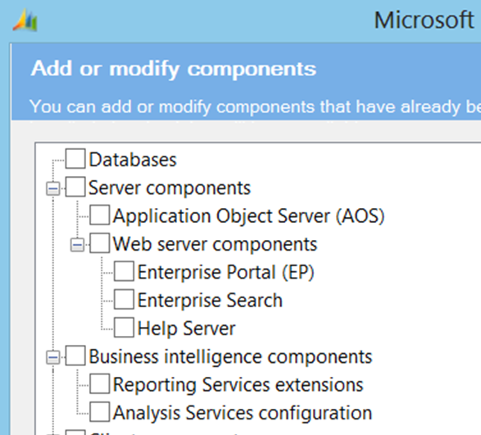

Reporting Services Extensions Installation
Install Reporting Services extensions.
Configure it to use the .NET Business Connector account.
Specify SSRS instance.
Deploy reports automatically, or manually, after installation is complete.
Notes:
Procedure: Install the Reporting Services extensions
Use this procedure to install the SQL Server Reporting Services extensions. You must complete this procedure on the computer that is running Reporting Services.
This procedure assumes that you are installing the Reporting Services extensions on a dedicated server where no other Microsoft Dynamics AX components are installed.
Start the Microsoft Dynamics AX Setup wizard. Under Install, select Microsoft Dynamics AX components.
On the Add or modify components page, select Reporting Services extensions. Click Next.
On the Prerequisite Validation page, resolve any errors. For more information about how to resolve prerequisite errors, see Check prerequisites. When no errors remain, click Next.
On the Specify Business Connector proxy account information page, enter the password for the proxy account that is used by the .NET Business Connector. Click Next.
On the Specify a Reporting Services instance page, follow these steps:
Select a Reporting Services instance.
Select the Deploy reports check box to deploy the default reports that are included with Microsoft Dynamics AX to the Reporting Services instance.
Click Next.
On the Prerequisite Validation page, resolve any errors. When no errors remain, click Next.
On the Ready to install page, click Install.
Click Finish to close the Setup wizard.

Slide 19
Report Deployment
Deploying reports to Reporting Services does the following:
Uploads the Report Definition Language (RDL) file, which is the report, to the Reporting Services server
Copies the business logic assemblies to the Reporting Services server
Ensures that the cross-referenced report and business logic assemblies are present to have a valid report deployed

Slide 20
Report Deployment Options
Microsoft Dynamics AX
Deploy from a developer workspace in the Microsoft Dynamics AX client.
AOT > SSRS Reports > Reports > right-click a report > Deploy Element.
Reports are deployed for all translated languages.
Visual Studio
Solution Explorer > Right-click reporting project > Deploy.
The reports are deployed for the neutral (invariant) language only.
Windows PowerShell
Scriptable deployment option.

Slide 21
Lab 2: Deploy Reports
Lab Scenario
You have just finished modifying three new reports: "SalesInvoice," "SalesAnalysis," and "SalesConfirm." You have moved the reports into the TEST environment and now you must deploy the reports using Windows PowerShell to verify that the report runs correctly.
Notes:
Go to Start > Administrative Tools.
Right-click Microsoft Dynamics AX 2012 Management Shell, and then select Run as Administrator.
Type the following command: Publish-AXReport -ReportName SalesInvoice, SalesAnalysis, SalesConfirm, and then press Enter.
Verify that the reports have successfully deployed.

Slide 22
Report Server Configuration
When you install the business intelligence components for Microsoft Dynamics AX 2012, setup will automatically create a report server configuration.
Configure Microsoft Dynamics AX Report Server
System administration > Setup > Business Intelligence > Reporting Services > Report servers
Configure Reporting Server Instance
Start > All Programs > Microsoft SQL Server > Configuration Tools > Reporting Services Configuration Manager
Notes:
When you install the business intelligence components for Microsoft Dynamics AX 2012, setup will automatically create a report server configuration. Setup uses the information provided in the wizard to set the parameters in each field.
You can use the Report server form to manage Microsoft Dynamics AX AOS connections to a SQL Server Reporting Services instance. This might be necessary, for example, when setting up a test environment, or after refreshing the data in a test environment from a production server, make sure to configure the report server so they are configured to point to the correct test servers instead of the production servers.
Open System administration > Setup > Business Intelligence > Reporting Services > Report servers.

Slide 23
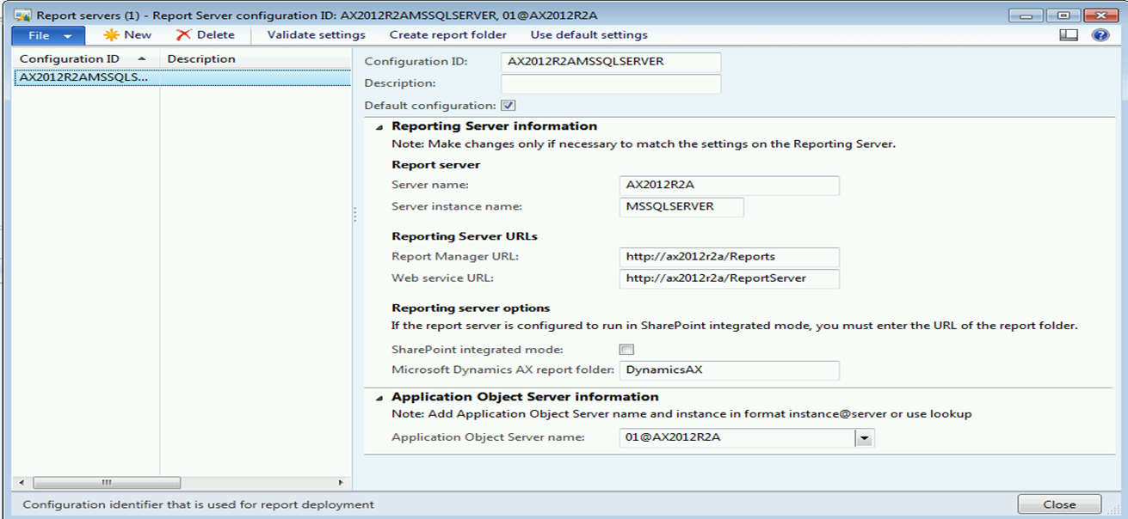
Configure Microsoft Dynamics AX Report Server
Review the Report Server configuration by using the Report Server Configuration form in Microsoft Dynamics AX.
System administration > Setup > Business intelligence > Reporting Services > Report servers

Slide 24
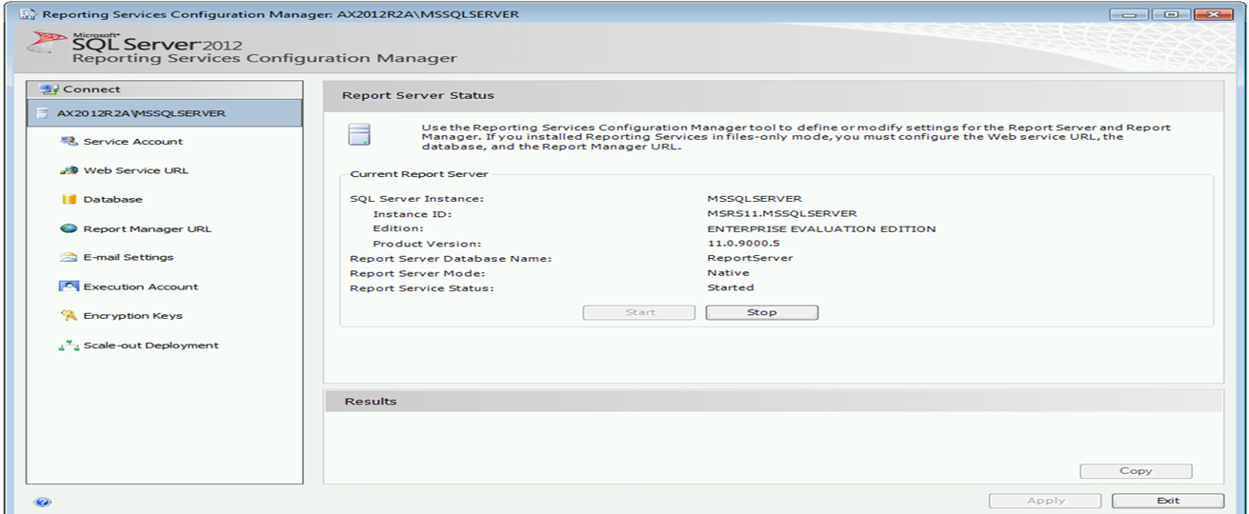
SSRS Report Servers Instance
Review the Reporting Services configuration by using the Reporting Services Configuration Manager tool:
Start > All Programs > Microsoft SQL Server > Configuration Tools > Reporting Services Configuration Manager to open Reporting Services Configuration Manager

Slide 25
Reports in Role Centers
Microsoft Dynamics AX report web part.
Add the web part to a page.
Select a report to display in the web part.
Select parameters to filter the data displayed on the report.

Slide 26
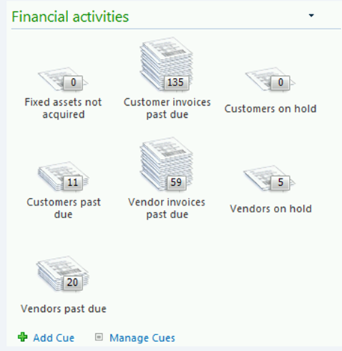
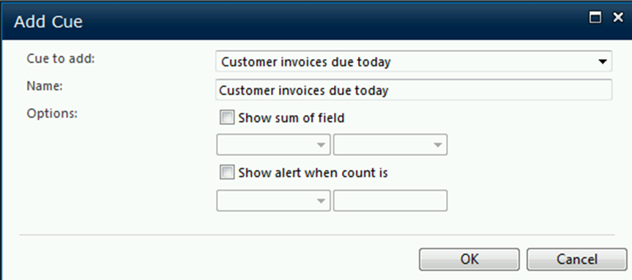
Configure Role Center
Scenario
You would like to add the "Budget amendments" cue to the Accountant Role center.
Procedure
System Administration > Common > Users > User Profiles > Accountant > View role center > Site Actions > Edit Page
Notes:
Procedure: Configure Role Centers
To add the "Customer invoices due today" cue to the Accountant Role center, follow these steps:
Go to System Administration > Common > Users > User Profiles.
Select the record for "Accountant".
Click View role center.
In the upper-left corner, click Site Actions > Edit Page.
In the right column, on the bottom of the "Financial activities" cue group, click Add cue.
In the Cue to add field, select Customer invoices due today.
Click OK.
In the upper-left corner, select Stop Editing.

Slide 27
Security
Reports are fully-integrated into the Microsoft Dynamics AX security system.
Microsoft Dynamics AX tables, fields, and server methods secured at the server level.
Microsoft Dynamics AX provides out-of-the-box security tasks and role definitions for report menu items that are shipped with Microsoft Dynamics AX 2012.
Notes:
Reports are fully-integrated into the Microsoft Dynamics AX security system. When you secure data by using tasks and roles, reports automatically respect that security. The main changes to security for reports include the following:
Detach DATAAREAID from security semantics
Secure tables, fields, and server methods at the server level in such a way that sensitive data does not leave the server
Create out-of-the-box security tasks and role definitions for report menu items that are shipped with Microsoft Dynamics AX 2012
SSRS Report Security
SQL Server reporting server has two types of roles to secure its service. There are System Roles for administrating the system-level security service, and Roles for accessing item-level security content that it serves. There are five default roles defined for content access.
Microsoft Dynamics AX Setup adds a specific Role DynamicsAXBrowser. Domain users or groups that are assigned to this role on the DynamicsAX folder are granted Browse access to all SRS reports in this folder, and to all folders and reports underneath this folder, through inheritance.
Changes to roles can only be made in SQL Server Management Studio connected to the SQL Server reports server.

Slide 28
Security
To grant users access to reports, you must complete the following tasks:
Configure role based security in Microsoft Dynamics AX.
If you are running Reporting Services in native mode, assign users to the DynamicsAXBrowser role on the Report Manager website.
If you are running Reporting Services in SharePoint integrated mode, grant users Read permission to the document library that stores the reports.
Assign users to roles in SQL Server Analysis Services.
Notes:
Procedure: Grant Users Access to Reports
To grant users access to reports, you must configure security settings in Microsoft Dynamics AX and in SQL Server Reporting Services. The following sections describe the tasks that you must complete in each application.
Configure security settings in Microsoft Dynamics AX
Complete the following tasks in Microsoft Dynamics AX:
Determine which reports each Microsoft Dynamics AX role should have access to.
Verify that each Microsoft Dynamics AX role has the correct duties and privileges assigned to it in order to access the reports.
Assign users to Microsoft Dynamics AX roles.
Secure the data shown in reports.
Configure security settings in Reporting Services
Complete the following tasks in Reporting Services:
Assign users to the DynamicsAXBrowser role in Reporting Services. For detailed instructions about how to assign users to Reporting Services roles, refer to the SQL Server documentation on MSDN.
Assign user accounts to the DynamicsAXBrowser role in Reporting Services. For detailed instructions about how to assign users to Reporting Services roles, refer to the SQL Server documentation on MSDN.
Restrict access to report folders and reports. Reporting Services includes security features and tools that you should use to help control access to report folders and published reports. Refer to the SQL Server documentation on MSDN for detailed conceptual information and step-by-step tutorials that will help you administer security in Reporting Services.

Slide 29
Upgrade
SSRS reports in Microsoft Dynamics AX 2009
Recommend not upgrading existing reports.
Use existing Microsoft Dynamics AX 2012 Reporting Services reports as a template and customize to meet your needs.
X++ reports in Microsoft Dynamics AX 2009
Recommend not upgrading existing reports.
Use the Report Data Provider approach to translate X++ business logic code in a class that can be used by SSRS reports.

Slide 30
Test Your Knowledge
The class will complete this section

Slide 31
Chapter Review
Which tool is used to deploy reports in Microsoft Dynamics AX 2012?
( ) Microsoft Dynamics AX 2012 Reporting Project Deployment form
( ) Command prompt
( ) Windows PowerShell
( ) None of the above
Which technology is used to access report data in Microsoft Dynamics AX 2012 SSRS reports?
( ) Microsoft Dynamics AX 2012 Business Connector .NET
( ) Services
( ) Windows PowerShell
( ) Direct SQL Server

Slide 32
Chapter Review
Put the following steps in order:
_____: A user requests a report.
_____: The report is displayed to the user.
_____: The AOS receives the request and sends the report data back to Reporting Services.
_____: Reporting Services receives the request and asks the AOS for the report data.
_____: Reporting Services renders the report and sends it to the Microsoft Dynamics AX client.

Slide 33
Chapter Review
Which of the following statements are true about failover clusters?
( ) Failover clustering is not supported for the report server database.
( ) Failover clustering is supported only for the report server database.
( ) Failover clustering is supported only for the Reporting Services Windows service.
( ) Failover clustering is supported for the report server database and for the Reporting Services Windows service.
What steps will the Microsoft Dynamics AX Setup wizard follow when you install business intelligence components? (Select all that apply.)
( ) Verify that prerequisite software has been installed on your server.
( ) Prompt you to select a SQL Server Analysis Services instance.
( ) Install Microsoft Dynamics AX 2012 Reporting Extensions.
( ) Prompt you to select a SQL Server Reporting Services instance.

Slide 34
Chapter Review (Answers)
Which tool is used to deploy reports in Microsoft Dynamics AX 2012?
( ) Microsoft Dynamics AX 2012 Reporting Project Deployment form
( ) Command prompt
(x) Windows PowerShell
( ) None of the above
Which technology is used to access report data in Microsoft Dynamics AX 2012 SSRS reports?
( ) Microsoft Dynamics AX 2012 .NET Business Connector
(x) Services
( ) Windows PowerShell
( ) Direct SQL Server

Slide 35
Chapter Review (Answers)
Put the following steps in order:
___1__: A user requests a report.
___5__: The report is displayed to the user.
___3__: The AOS receives the request and sends the report data back to Reporting Services.
___2__: Reporting Services receives the request and asks the AOS for the report data.
___4__: Reporting Services renders the report and sends it to the Microsoft Dynamics AX client.

Slide 36
Chapter Review (Answers)
Which of the following statements are true about failover clusters?
( ) Failover clustering is not supported for the report server database.
(x) Failover clustering is supported only for the report server database.
( ) Failover clustering is supported only for the Reporting Services Windows service.
( ) Failover clustering is supported for the report server database and for the Reporting Services Windows service.
What steps will the Microsoft Dynamics AX Setup wizard follow when you install Reporting Services extensions? (Select all that apply.)
(x) Verify that prerequisite software has been installed on your server.
( ) Prompt you to select a SQL Server Analysis Services instance.
(x) Install Microsoft Dynamics AX 2012 Reporting Extensions.
(x) Prompt you to select a SQL Server Reporting Services instance.

Slide 37
Chapter Summary
In this chapter, we reviewed the following topics:
Reporting architecture
Planning considerations
Running a report in batch
Installing and deploying SSRS reports
Configuring a report server
Security considerations

